Slide 1

City of Baltimore
Fiscal 2015 Preliminary Budget Plan
April 1st, 2014
Department of Finance

Slide 2
Budget Highlights
No service cuts or tax increases while continuing to implement the 10-Year Financial Plan
Reduces the effective property tax rate to $2.13 per $100, a 6% reduction since 2012
Provides $26M in new GF capital investment
Increases employee pay
Further streamlines the workforce
Grows Budget Stabilization Reserve, accelerates debt repayment, and shores up workers’ compensation funding

Slide 3
Fiscal 2015 by the numbers
Total, all-funds budget of $3.39B
Operating budget of $2.49B, +3.5% from FY 2014
  General Fund Operating of $1.62B, $51M (3.2%) above Fiscal 2013 and $15.2M (1%) above CLS
Capital budget of $897M
  72% for water and wastewater infrastructure
General Fund positions total 10,121 vs. 10,138 in Fiscal 2014

Slide 4
Current Services Budget by the Numbers
Fiscal 2015 Budget Adjustments

Slide 5
General Fund Current Services
Budget by the Numbers
Budget Adjustment | Cost
Pay Increases | $16.5m
Pension Costs | $7.2m
General Inflation for non-personnel line items | $5.7m
Workers Comp | $4.1m
Police Legal Fees | $2.5m
Software Upgrade Costs | $2.0m
Landfill Development | $2.0m
Street Sweeping | $1.6m
Asbestos Remediation | $1.0m
Adjustment to Visit Baltimore appropriation based on Hotel Tax | $1.0m
Funding for City Wellness Initiative | $1.0m
Teacher Pension | -$1.5m
Fire Overtime | -$2.4m
Debt Service | -$5.6m
TOTAL CHANGE FROM FISCAL 2014 ADOPTED | $35.0m

Slide 6
Key Fiscal 2015 Actions
Budget Stabilization, $6.75 Million
  Grows Budget Stabilization Reserve to 6.25%, the target is 8% by Fiscal 2018
Speed Camera Fund Balance Bridge, $5.5 Million
  Utilizes assigned fund balance to bridge revenue gap until traffic cameras are operational
Debt Repayment, $12.0 million
  Accelerates debt repayment to save the City $5 million over the next 10 years
Workers Compensation, $5.0 million
  Aligns the City’s approach to Worker’s Compensation funding with industry best-practices

Slide 7
Local Impact Aid
The Fiscal 2015 budget includes $10 million to support projects in the Horseshoe Casino Area
  $7 million will be available for projects on July 1st, $3 million will be become available when revenue exceeds the $7 million mark
Spending plan was developed with community through Local Development Corporation
Projects Include:
  Workforce Training & Employment Connection Center, $975k
  Infrastructure upgrades, $2.0 million
  Increased public safety & sanitation services in the casino area, $3.0 million
  Long range planning efforts, $1.2 million

Slide 8
State and Federal Funding
Federal Funding
  The Fiscal 2015 budget includes a slight increase for formula grants awarded through Housing and Urban Development
    The CDBG allocation is $19.6 million, a $30k increase from Fiscal 2014 levels
  $7.3 million for Head Start services, in Fiscal 2015 Head Start funding will be split between the City and 4 other providers
    The total funding between the four providers will be $30 million
  $300,000 from the Department of Commerce for the establishment of a Minority Business Development agency
State Funding
  Continued funding for energy and weatherization projects through the Customer Investment Fund and Empower Maryland
    The Customer Investment Fund provides $52 million for energy projects over 3 fiscal years
  $2.0 million to extend the Charm City Circulator Purple Route
Special Funding
  $10 million in Local Impact Aid from the Horseshoe Casino

Slide 9
Utility Funds
The Stormwater rates from property owners will remain consistent with Fiscal 2014 levels, Water/Wastewater rates will increase 11% in Fiscal 2015
Major Highlights
  Implementation of Advanced Metering Infrastructure (AMI) and Automated Meter Reading (AMR) to make meter reading more reliable, accurate, and timely
  Creation of the Asset Management Division to monitor the City’s underground water infrastructure & prioritize areas for capital investment
Key Performance Targets:
  220 million gallons of water will be treated daily
  The Department of Public Works will rehab or replace 146,028 linear feet of the water distribution system, an increase from 39k in Fiscal 2013

Slide 10
TEN YEAR FINANCIAL PLAN UPDATE

Slide 11
Updated Projection:
Including Fiscal 2014 Initiatives
Original Projection
Projection with FY14 Initiatives
Baseline projection reflects health benefit changes and 20 cents by 2020 property tax relief plan

Slide 12
Changes vs. 10-Year Plan
10-Year Plan Cumulative Gap ($745M)
Initiatives Completed $395M
Expenditure Baseline Change ($137M)
Revenue Baseline Change $ 15M
Current Cumulative Gap ($473M)

Slide 13
10-Year Plan Initiatives Completed in Fiscal 2014
10-Year Plan Initiatives: Completed (In $ Millions)
 | 10-Year Plan | Current | Difference
Fire Shift | 121.4 | 72.3 | -49.1
ERS Reform | 153.4 | 80.5 | -72.9
Dependent Audit | 29.0 | 29.0 | 0.0
Fiscal 2014 Revenue Package | 33.2 | 39.5 | 6.3
Storm Water Fee (net of property tax) | 53.3 | 39.3 | -14.0
BCPS City Services Transfer | 9.0 | 0.0 | -9.0
Retiree pharmacy changes | 87.3 | 87.3 | 0.0
Other | 47.5 | 47.5 | 0.0
Total | $534.0 | $395.4 | $-138.6
The Fiscal 2014 budget included a full year of health benefit reform savings that were initiated in Fiscal 2013.
The Fiscal 2014 budget included a 2% pay raise for all employees.
The Fiscal 2014 budget included an additional installment of tax reduction as part of the Mayor’s 20 Cents by 2020 plan.
The ERS Reform initiative includes a new pension plan for future employees, which is still pending before City Council.

Slide 14
Updated Projection: Including Planned Initiatives

Slide 15
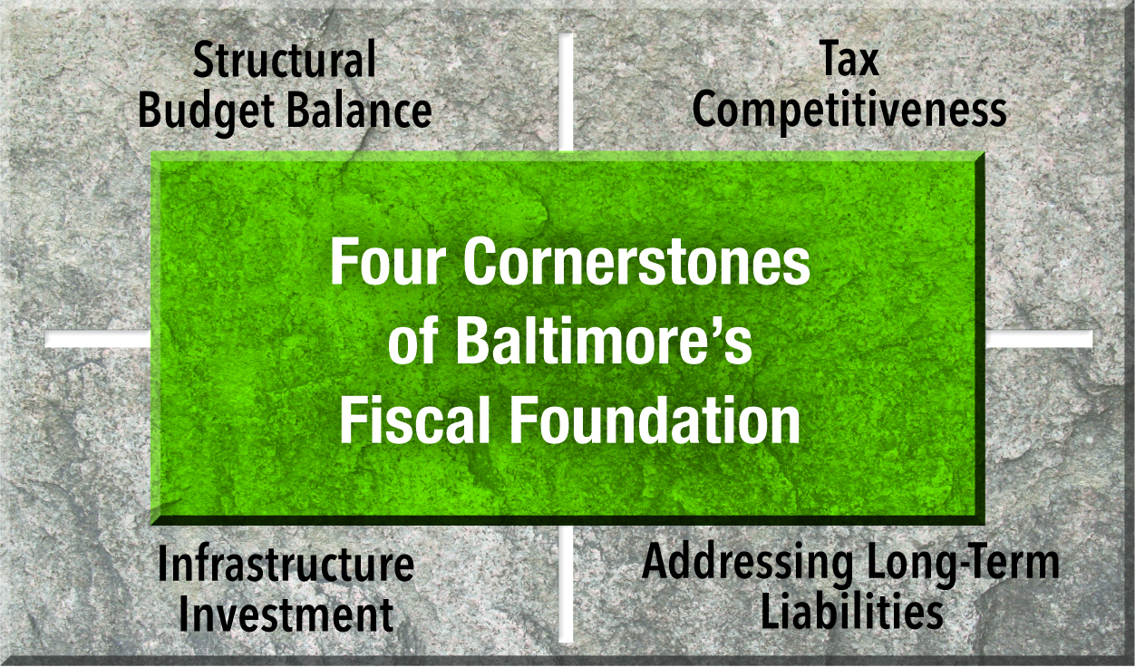
Ten-Year Financial Plan:
Fiscal 2015 and Beyond
Structural Budget Balance: A hybrid pension system for new sworn Fire and Police Employees, continued workforce streamlining, VOIP to reduce telephone costs, Fleet Rightsizing, further changes to health benefit cost-sharing.
Tax Competitiveness: Establishment of a Solid Waste Enterprise, renewal of existing MOU with City non-profits that offers an equitable approach to sharing the cost of services, property tax reduction beyond 2020.
Infrastructure Investment: Continued PAYGO capital funding above baseline, increased GO Bond issues, extension of country transportation bond borrowing.
Addressing Long-Term Liabilities: Increase contribution to the Budget Stabilization Reserve, share retiree health benefit costs with BCPS, continue to rebalance employee compensation

Slide 16
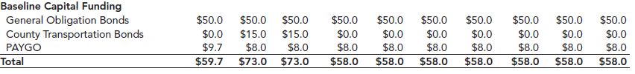
Capital funding falls short of needs
Planned General Fund capital spending falls $1.1B short of reasonable needs over the next 9 years.

Slide 17
10-Year Plan Initiatives:
Annual PAYGO funding

Slide 18
fiscal 2015 revenue outlook

Slide 19
Revenues are recovering positive growth trend

Slide 20
Constrained housing inventory drives prices higher

Slide 21
Property values show signs of City’s housing market recovery
Notes:
In Maryland, property assessment increases are phased in over a three year period.
First increase since Fiscal 2011.
Assessment increase in Group II is composed by 4.4% on residential properties and 10.3% on commercial properties.

Slide 22
Property tax showing recovery as economy improves

Slide 23
In the face of fiscal distress, the city has cut the property tax rate

Slide 24
Employment Recovering Slowly

Slide 25
Income taxes are following employment

Slide 26
Highway User Revenues are still down nearly $100M since Fiscal 2007

Slide 27
Fixed cost trends

Slide 28
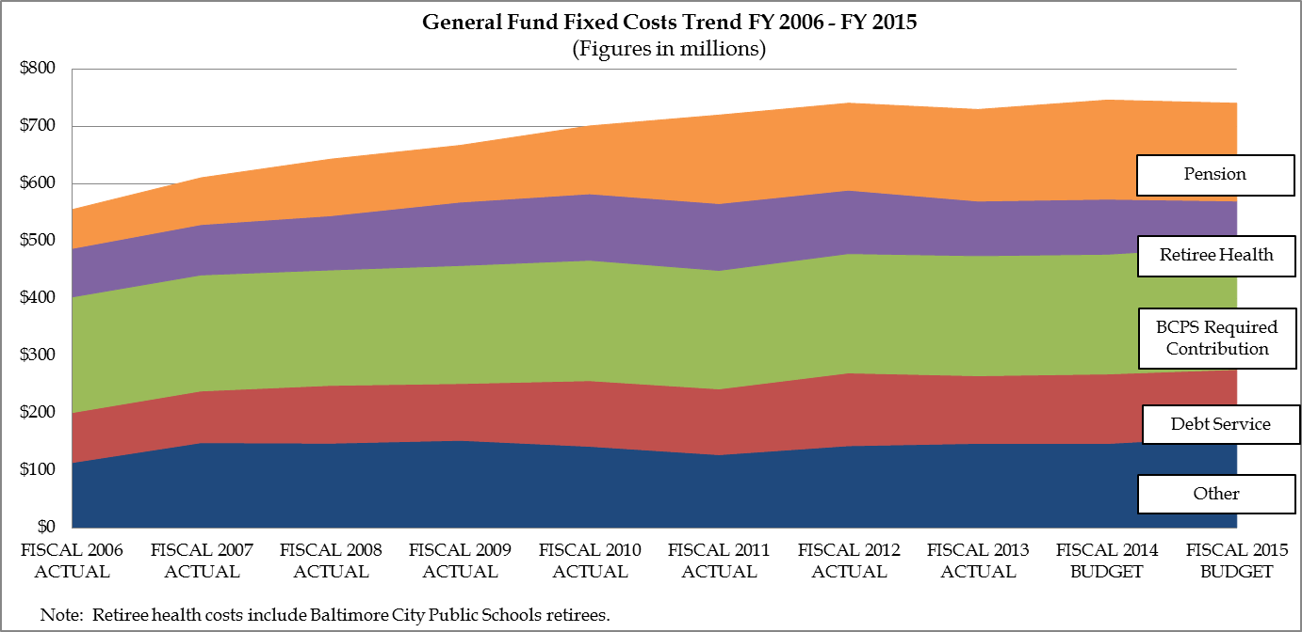
Fixed costs 33% above FY 2006
But pension reform and health care savings are bringing costs under control

Slide 29
The city has “bent the curve” on fixed costs

Slide 30
Reforms have reduced pension cost growth

Slide 31
Health benefit changes are saving the city $100 million vs. baseline

Slide 32
Unfunded liabilities have shrunk by $400 million
Unfunded Pension and OPEB Liabilities
(Figures in Millions)
OPEB: Other post-employment benefits, namely retiree health care coverage.
FPERS: Fire and Police Employees' Retirement System.
ERS: Employee Retirement System for civilian employees.
Note: The relatively small Elected Officials' Retirement System is not shown; this system was valued at $1.6 million as of June 30, 2012,
and was 109% funded.
Total
$3,176.5
Total
$2,776.6

Slide 33
Recommended budget plan FOR FISCAL 2015

Slide 34
PRIORITY-DRIVEN
  MAYOR RAWLINGS-BLAKE’S PRIORITY OUTCOMES FOR GROWING BALTIMORE
  Better Schools
  Safer Streets
  Stronger Neighborhoods
  A Growing Economy
  Innovative Government
  A Cleaner and Healthier City

Slide 35
Better Schools
Total Recommended Budget=$354,618,028
Key Highlights
  Fully funds the city’s Maintenance of Effort (MOE) payment to the Baltimore City Public School System (BCPS) at $204 million.
  Keeps all library branches open and extends Sunday hours of operation to improve third-grade reading and support life-long learning.
  Maintains funding of $5.9 million for Out of School Time (OST) programs administered by the Family League of Baltimore City. Funding for these programs has grown by $1.2 million over the past four years.
  Begins the transition of the City’s two daycare centers to year-round Head Start centers. In Fiscal 2015 the Mayor’s Office of Human Services will operate the facilities in their current state in order assess the quality of early child care education and provide optimal educational opportunities for all of the children

Slide 36
Better Schools
Priority Goals
  Increase Student Attendance
  Decrease the Dropout Rate
  Increase Kindergarten Readiness
  Increase Reading Proficiency
  Improve College & Career Readiness among high school graduates

Slide 37
Better Schools
Increase Student Attendance
School Health Services will seek to increase the number of children returning to the classroom from 84% to 85%, among the 410,000 visits to school health suites annually
Through their Community Resource Schools, the Family League anticipates 90% of elementary school participants will achieve good attendance (absent 20 days or less). In Fiscal 2015 there will be 42 Community Resource Schools

Slide 38
Better Schools
Increase the Percentage of 3rd Graders Reading at the Proficient Level
The Enoch Pratt Free Library will host 50,000 student participants in its Summer Reading program

Slide 39
Safer Streets
Total Recommended Budget=$802,970,137
Key Highlights
  Funding for various crime reduction initiatives including Operation Ceasefire, extended curfew centers, gun buy back and night basketball
  Invests $5 million from seized drug contraband for technology and capital upgrades within the Police Department
  Fully funds EMS services while investing in new technology to track the location of medic units and steps to reduce delays in transferring patients to emergency rooms will help improve response times.
  Supports the purchase of 8 medic units, 4 engines, 2 air flex units, 2 ladder trucks, 1 rescue unit, 1 hazmat unit, & 4 utility vehicles

Slide 40
Safer Streets
Priority Goals
  Increase Citizen Perception of Safety
  Decrease Violent Crime
  Decrease Property Crime
  Improve Fire Response Time
  Improve Emergency Medical Service Response Time

Slide 41
Safer Streets
Increase the percentage of citizens that rate the City safe or very safe.
The Mayor’s Office of Criminal Justice will maintain and operate 700 crime cameras throughout Baltimore
The Police Department will continue to implement community outreach strategies resulting in a 70% satisfaction rate with Police approachability, an increase from 59% in Fiscal 2013

Slide 42
Safer Streets
Reduce violent crime rate
The Police Department will seek to seize 650 guns and complete 450 gun arrests
The Police Department will pursue 3,200 arrest warrants obtained by investigative units while seeking a 60% homicide clearance rate

Slide 43
Safer Streets
Percent of Fire and EMS 911 calls meeting national response time standards.
EMS units will respond to 146,000 calls for assistance and transport 87,000 patients; the service will response to 90% of EMS calls within 10 minutes
Fire Communications will seek to dispatch 90% of calls within one minute

Slide 44
Stronger Neighborhoods
Total Recommended Budget=$215,480,369
Key Highlights
  Reduces the effective property tax rate for city homeowners to $2.13 per $100 of assessed value, representing an 11 cent (6%) cut over three years under the Mayor’s 20 Cents by 2020 initiative.
  Maintains funding for recreation centers, public pools, and park maintenance.
  Fully funds Housing Code Enforcement and Blight Elimination services to support implementation of Whole Block Demolition

Slide 45
Stronger Neighborhoods
Priority Goals
  Reduce blight in Baltimore
  Improve condition of private neighborhood properties
  Improve quality of neighborhood right-of-ways
  Increase citizen satisfaction with neighborhood services
  Increase civic engagement

Slide 46
Stronger Neighborhoods
Reduce blight and return vacant neighborhood structures and land to productive use.
Through Code Enforcement Activities 1,200 vacant structures in targeted areas will be made habitable
The Land Resources Division with HCD will sell approximately 275 City-owned properties, returning these properties to the City’s tax rolls

Slide 47
Stronger Neighborhoods
Improve the quality of rights of way in neighborhoods.
Street Management will seek to resurface 140 lane miles of Baltimore roadways and repair 100% of potholes within 48 hours of reporting
Traffic Management will seek to ensure traffic flows are at the optimal travel times 90% of the time

Slide 48
Stronger Neighborhoods
Improve Citizen Usage of and Satisfaction with neighborhood-based services and amenities
Recreation Centers will provide out-of-school time recreational opportunities for 325,000 participants, an increase of 12,000 from Fiscal 2013
Park Maintenance will work to ensure 92% of playground areas have 100% functional components, a 4% increase from Fiscal 2013

Slide 49
A Growing Economy
Total Recommended Budget=$128,215,348
Key Highlights
  Supports economic development efforts to assist small businesses, encourage technology entrepreneurs, and attract and retain jobs.
  Maintains funding for the Youth Works Summer Job Program, which will partner with private and non-profit employers to give more than 5,000 young people meaningful work experiences.
  Maintains funding for key cultural institutions, such as the art museums, Baltimore Symphony Orchestra and the Baltimore Office of Promotion and the Arts.
  Provides ongoing enhancement funding for a Food Desert strategy geared towards connecting urban farmers and convenience stores.

Slide 50
A Growing Economy
Priority Goals
  Increase the number of residents with a job
  Increase the number of businesses in the City
  Increase economic activity from tourism and entertainment
  Increase retail activity
  Increase cultural opportunities

Slide 51
A Growing Economy
Increase the number of City residents who are employed
Baltimore Development Corporation will work to retain or add 3,995 jobs in the City
The Department of Planning, through the Food Desert strategy, will assist creating 200 jobs by supporting the construction of full-size grocery stores, an increase of 70 jobs from Fiscal 2013

Slide 52
A Growing Economy
Increase the overall number of businesses in the City.
BDC will work to attract or assist expansion efforts for 50 businesses in Baltimore’s commercial corridors
The Small Business Resource Center will work to assist 300 businesses & the Emerging Technology Center will support 50 new companies; in Fiscal 2013 the SBRC assisted 226 businesses while the ETC supported 35 companies

Slide 53
A Growing Economy
Increase economic activity from tourism and entertainment and attraction offerings
The Department of Transportation will assist in 250 special events throughout the City
Visit Baltimore will seek to book 500,000 hotel rooms for future conventions, an increase from 469,675 in Fiscal 2013

Slide 54
Innovative Government
Total Recommended Budget=$261,820,205
Key Highlights
  Funds an expanded Office of Inspector General and continues funding to carry out a new charter requirement for periodic audits of city agencies.
  Eliminates 23 vacant positions and begins consolidation of the Human Resources function, consistent with the Mayor’s plan to streamline the city workforce by ten percent over ten years.
  Includes $1.8 million to bring managerial and professional salaries into a market competitive range and implement a pay for performance plan for executives.
  Invests in two new Innovation Fund projects that will modernize the Police Department’s Crime Laboratory and provides funding for Lean Government events, employee training, and other initiatives to improve efficiency and customer service.

Slide 55
Innovative Government
Priority Goals
  Maintain a well-trained workforce
  Increase customer satisfaction
  Reduce the City’s energy costs
  Reduce space utilization costs
  Increase citizens’ access to City services

Slide 56
Innovative Government
Increase the percentage of customers satisfied with City services.
The average Call Center wait time at the Revenue Collections call center will decrease from a previous target of 10 minutes to 7 minutes
The Department of Human Resources will work to decrease the average number of days to fill a vacancy from 80 days to 60 days

Slide 57
Innovative Government
Increase citizens accessibility of City services
MOIT will ensure 14 different bill types can be paid online
The 311 Call Center will assist 440,000 callers related to City services and general information requests and inquiries

Slide 58
Innovative Government
Reduce the City’s energy costs
The Department of General Services, through the Energy Office, will seek to reduce the City’s cumulative energy costs by 74 million kWh
The number of fully depreciated vehicles in the City’s fleet will decrease by 9%; these vehicles are being replaced with more fuel efficient models

Slide 59
A Cleaner and Healthier City
Total Recommended Budget=$592,211,668
Key Highlights
  Continues support for the mechanical street sweeping operation that has increased the number of lane miles swept
  Maintains funding for 1+1 trash and recycling collection, graffiti removal, and street and alley cleaning.
  Maintains support for the Environmental Health service, which has adopted electronic handheld devices to improve efficiency and increase the total number of health inspections conducted at food facilities and other establishments.
  Continues enhanced funding for Baby Basics, a prenatal health literacy program that reduces risks of poor birth outcomes for low-income mothers.

Slide 60
A Cleaner and Healthier City
Priority Goals
  Decrease the number of alcohol and drug-related ER visits
  Decrease health inequalities
  Decrease infant mortality
  Increase citizen satisfaction with the City’s cleanliness
  Increase recycling rates

Slide 61
A Cleaner & Healthier City
Decrease the rate of alcohol and drug-related emergency visits
Substance Abuse and Mental Health will seek to retain 60% of clients in outpatient treatment for at least 90 days
The Office of Human Services will work to move 60% of individuals utilizing temporary housing to permanent housing, a 40% increase from Fiscal 2013

Slide 62
A Cleaner & Healthier City
Increase citizen satisfaction with City’s cleanliness
Public Right-of-Way Cleaning will increase the number of lane miles swept from 97,000 to 150,000
Urban Forestry, after having reduced a historical backlog, will reduce the average number of days between tree inspection and removal from 100 days to 60 days

Slide 63
A Cleaner & Healthier City
Increase the amount of waste material re-used or recycled.
The Department of Public Works will divert 22% of waste tonnage through recycling
The Planning Department will initiate 80% of strategies identified in the Baltimore Sustainability long range plan; among these strategies is the Waste to Wealth initiative

Slide 64
State and Federal Funding
Governor O’Malley’s budget protects State aid, but revenue write downs and pension funding issues create uncertainty
HUR down $6 million from previous estimates
The City and BCPS are seeking a waiver from MSDE to correct the MOE amount, which would save $2.0M

Slide 65
Capital budget overview

Slide 66
Capital Budget Overview
The Fiscal 2015 Capital Budget recommendation is $898 million
The Capital Budget includes:
  $25.7 million in PAYGO funding to support investments in recreation projects, whole block demolition, and street resurfacing efforts
  $50 million in Bond funds to support school renovation & modernization, economic development initiatives, and human service projects
  $145 million in State and Federal funds to support capital initiatives throughout the City

Slide 67
Capital Budget:
Where the Money Comes From

Slide 68
Capital Budget:
How the Money is Used

Slide 69
Better Schools
Key Projects
  $17.0 Million for Baltimore City Public Schools
    $13.0 Million for improvements to building systems at Baltimore City Public School facilities
    $4.0 Million to replace the existing elementary Holabird & Graceland Park O’Donnell Heights Elementary Middle Schools
    This funding is separate from the $1.1 Billion 10-Year School Construction Plan
  $27.9 Million for the Enoch Pratt Free Library
    $1.9 million to renovate the Hampden Library Branch
    $26.0 million for renovations at the Central Library Branch
      This funding is part of a $103 Million full renovation of the Central Library to be completed over the next 5 years

Slide 70
Safer Streets
Key Projects
  $5.0 Million for technology improvements within the Police Department
  $200k to support implementation of Police Station Master Plan
  $1.2 million for design and construction of a mid-size courtroom in the Clarence Mitchell Courthouse

Slide 71
Stronger Neighborhoods
Key Projects
  $16.6 Million for Recreation & Parks projects
    $5.4 Million for construction of Cahill Community Center
    $2 Million for Cherry Hill Indoor Pool
    $1 Million for Winans Meadow Nature Center
    $1 Million for Druid Hill Park Community Service Center
  $103.4 Million for Transportation related projects
    $13.3 Million for street resurfacing within City neighborhoods
    $23 Million for Central Avenue Streetscaping
    $3.4 Million for Citywide Bike Improvement program
    $6.6 Million for Lafayette Avenue bridge construction over Amtrak
  $45.6 Million for Housing related projects
    $10.5 million for demolition efforts
    $5.3 million for the Baltimore Home Ownership Program (BHIP)
    $5.4 million for Housing Development projects

Slide 72
A Growing Economy
Key Projects
  $8.8 Million for economic development initiatives
    $1.0 Million for Westside Historic Property Stabilization
    $2.0 Million in infrastructure upgrades to the Russell Street area surrounding the Horseshoe Casino
    $2.0 Million to begin implementation of the Inner Harbor Master Plan
  $650,000 for Downtown Partnership
    $300k to continue implementation of the Pratt Street Master Plan
    $350k to improve the area around Lexington Market through the implementation of the Open Space Plan
  $5.2 Million for various City cultural institutions
    $3.7 million for Baltimore Museum of Art

Slide 73
Innovative Government
Key Projects
  $1.0 Million to develop a plan for a new Emergency Call Center independent of an electrical grid
  $500k for long-range planning efforts across the City including area master plans and oversight of the Capital Improvement Program
  $100k for investment and improvements in City owned historic buildings and landmarks

Slide 74
A Cleaner & Healthier City
Key Projects
  $654 Million for Public Works projects
    $1.0 Million for Stormwater Mitigation projects
    $306 Million for rehabilitation efforts at the Back River Waste Water Treatment Plant
    $87.1 Million for Water Infrastructure rehabilitation
    $1.3 Million for Citywide stream restoration projects
  $3.3 Million for Human Service projects
    $2.5 million for renovations and upgrades at Sarah’s Hope, Homeless Shelter for Women and Children
    $750k to create 13 permanent supportive housing developments with a total of 250 units for homeless individuals & families

